Slide 1
Information Visualization Visualization Sketch
G17-A
83473 – Hélio Domingos
83530 – Miguel Regouga
85080 – João Pina

Slide 2
Overview
01

Slide 3
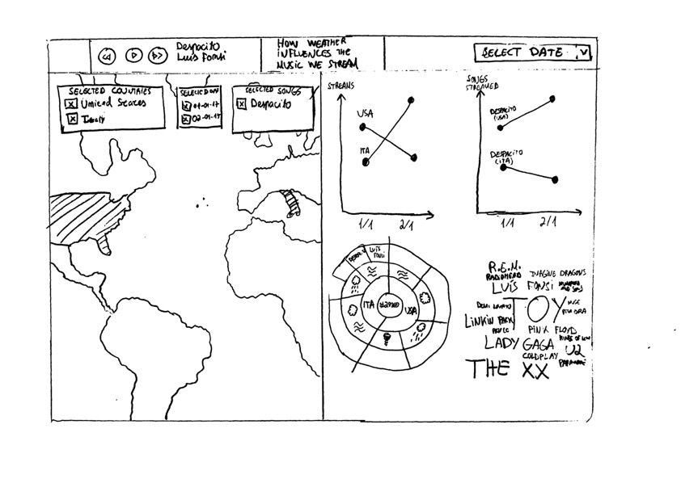
Overview
Notes:
Helio

Slide 4
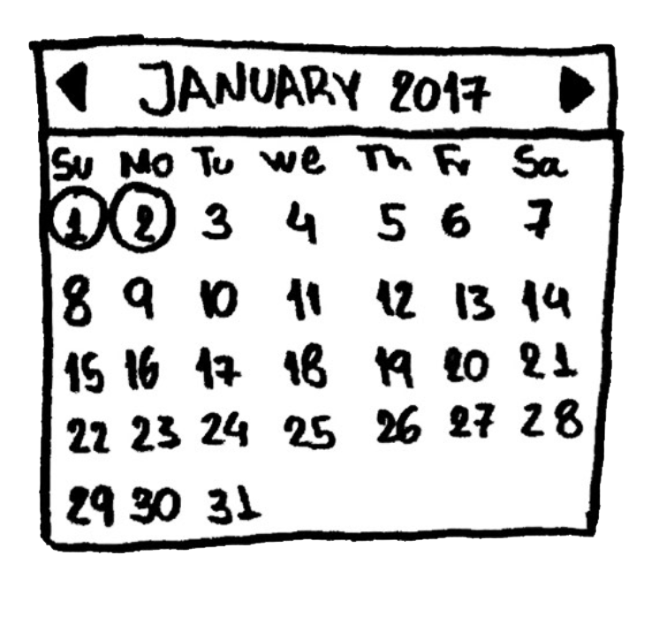
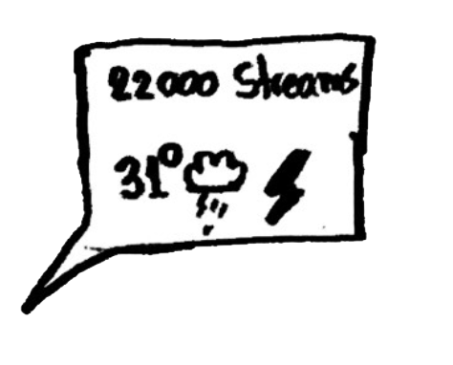

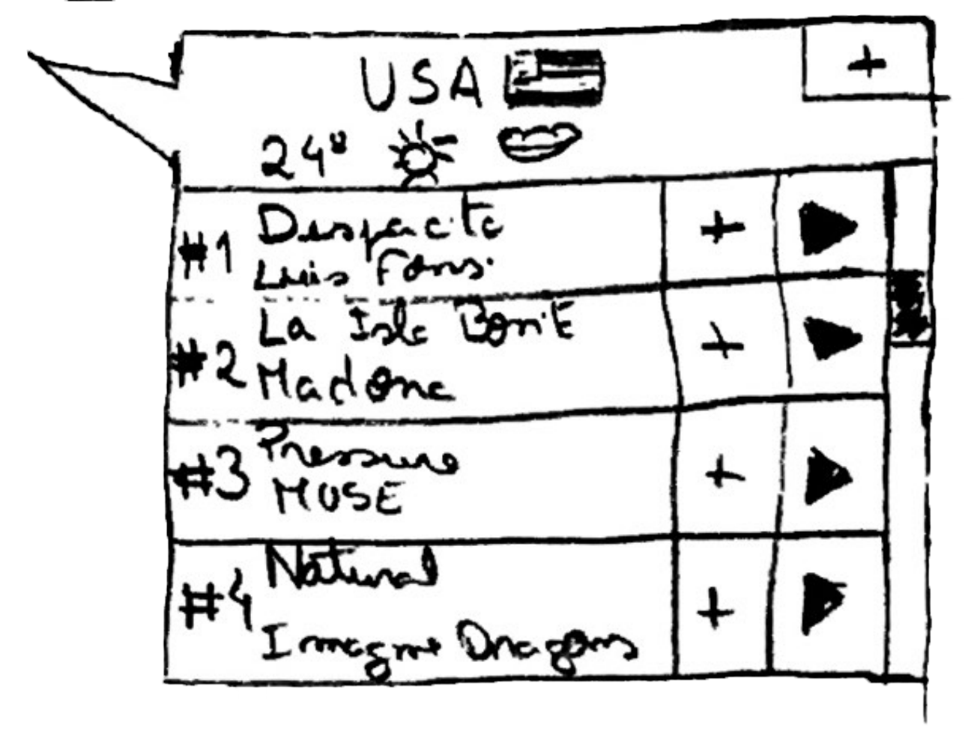
Overview
Notes:
Helio

Slide 5
Visual encoding
02

Slide 6
Visual Encoding
Choropleth map
The countries Spotify is available in are given by the colors on the map;
The countries selected by a user are given by a different and contrast color;
Notes:
Miguel

Slide 7
Visual Encoding
Line chart 1
The number of streams is given by the height in relation to the left axis;
The dates are given by the bottom axis;
The number of streams of a country on a day is given by a dot;
The difference between streams is given by each line.
Notes:
Miguel

Slide 8
Visual Encoding
Line chart 2
The songs and its number of streams is given by the height in relation to the left axis;
The dates are given by the bottom axis;
The number of streams of a given song on a country and day is given by a dot;
The difference between streams is given by each line.
Notes:
aniP

Slide 9
Visual Encoding
Sunburst
The countries selected are given in the first ring;
The weather conditions and its combinations are given on the second ring;
The artist information is given on the third ring with a different colour tone;
The song information is given on the fourth ring with a different colour tone;
The total number of streams is given on the centre of the sunburst;
The given data of each country is given by one different colour tone;
The given data of each weather condition is given by one different colour tone;
Notes:
aniP

Slide 10
Visual Encoding
Word Cloud
The number of streams of the artist is given by its size.
Notes:
Hélio

Slide 11
IDIOM – tasks/questions mapping
03

Slide 12
Idiom — Task Mapping
Choropleth map
Discover the most listened songs on a given day, on a given country, by clicking in each country
Analyse the weather conditions on a given day, on a given country, by clicking in each country
Compare two or more countries by selecting each desired country
Notes:
Hélio

Slide 13
Idiom — Task Mapping
Line chart 1
Identify the countries with more streams by analyzing the highest line on the graph
Compare the streaming numbers of multiple countries by day by analyzing the line behavior
Analyze how weather conditions influence the number of streams by hovering on the dots
Notes:
Miguel

Slide 14
Idiom — Task Mapping
Line chart 2
Identify how songs perform by country by analyzing the lines with the same color
Compare the streaming numbers of multiple countries by day by analyzing the line behavior
Analyze how weather conditions influence the number of streams by hovering on the dots
Notes:
Miguel

Slide 15
Idiom — Task Mapping
Sunburst
Analyze how weather conditions influence the song ranking by analyzing the 2nd and 3rd ring
Identify the number of streams by looking at the center of the ring
Discover the most listened songs given a weather condition by clicking in the desired weather condition
Notes:
aniP

Slide 16
Idiom — Task Mapping
Word Cloud
Identify the most streamed artists by comparing the sizes of different words in the cloud and locating the largest ones
Identify how many streams an artist had by hovering in its name
Notes:
aniP

